Slide 1
1.2.5 Probabilistic Information Retrieval
The notion of similarity in the vector space model does not have an explanation how it relates to relevance
The similarity values are just used to rank
An information retrieval model deals with uncertainty on the user's information needs
Probability theory provides a principled approach to reason about this uncertainty
Probabilistic IR models attempt to provide an explainable model of relevance
Notes:
One of the key drawbacks of the vector space retrieval model is the lack of interpretability of the similarity values. This gave rise to the development of probabilistic retrieval models, that attempt to determine relevance as a probabilistic concept with an explainable probabilistic model.

Slide 2
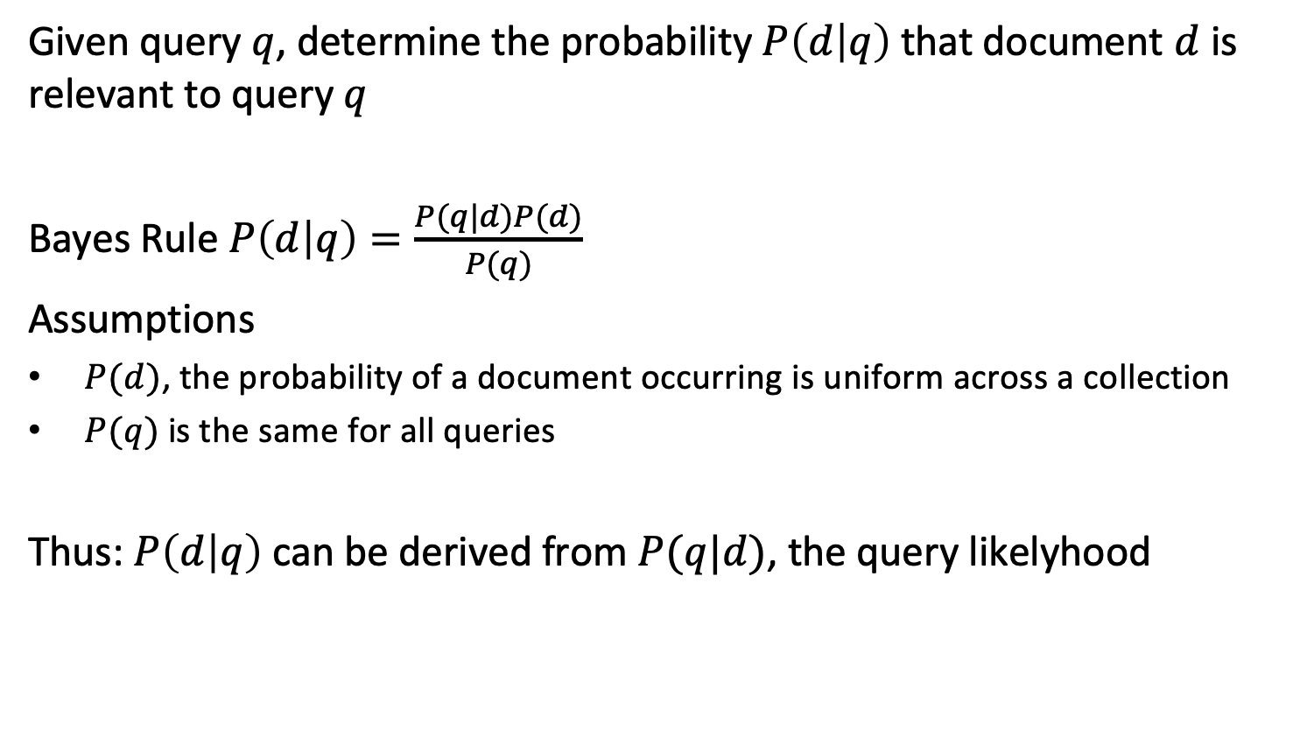
Query Likelihood Model
Given query $q$, determine the probability $P\left(d | q\right)$ that document $d$ is relevant to query $q$
Bayes Rule $P\left(d | q\right)=\frac{P(q|d)P(d)}{P(q)}$
Assumptions
$P(d)$, the probability of a document occurring is uniform across a collection
$P(q)$ is the same for all queries
Thus: $P\left(d | q\right)$ can be derived from$P(q|d)$, the query likelyhood
Notes:
In probabilistic retrieval the objective is to introduce a notion of probability that relates to the relevance of a document d with respect to a query q.
Since we can assume that the probability of a document to occur in a collection is constant (which is correct assuming all documents are different), and the probability of a query to occur is the same for all documents, using Bayes rule, the problem of determining whether a document is relevant for a query is equivalent to the problem of determining whether a query is relevant to a document. The latter probability $P\left(q | d\right)$ is also called the query likelihood.
So probabilistic IR can be framed as the question of what is the probability for a specific query to occur, given a specific document. One way to understand why the problem is formulated this way, is that it is more feasible to derive a rich model from a document, than from a query, which contains little information.

Slide 3
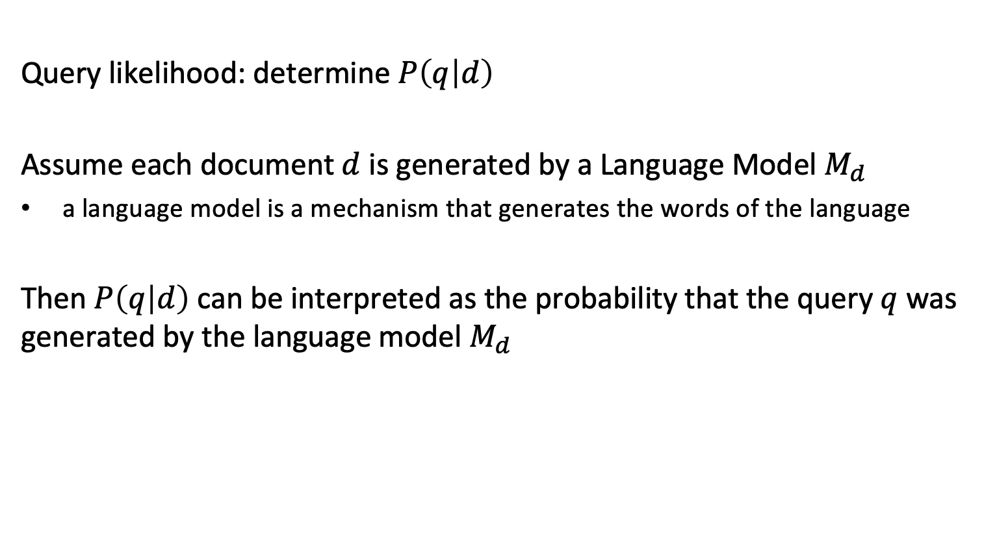
Language Modeling
Query likelihood: determine $P\left(q | d\right)$
Assume each document $d$ is generated by a Language Model $M_{d}$
a language model is a mechanism that generates the words of the language
Then $P\left(q | d\right)$ can be interpreted as the probability that the query $q$ was generated by the language model $M_{d}$
Notes:
The concept of query likelihood gives now rise to the following approach to capture relevance of a document to a query. We assume that documents are the result of language model. A language model is a (in general probabilistic) process that produces text, and a given document d is assumed to be produced by its specific language model M_{d}. Then the problem of retrieval can be viewed in the following way: if a query is relevant to a document, it should have been produced by the same language model as the document. Using this argument, the query likelihood corresponds to the probability that the query has been produced by the same language model as the document.
Let’s have now a more detailed look in what a language model is and how we use it implement this approach practically.

Slide 4
What is a Language Model?
Deterministic language model = automaton = grammar
This model can produce: “information retrieval” “information retrieval information retrieval”
It cannot produce: “retrieval information”
information
retrieval
Notes:
A very simple example of a generative language model is a deterministic automaton. Deterministic automatons are used to recognize or produce regular languages.

Slide 5
Probabilistic Language Model
Unigram model: assign a probability to each term to appear
More complex models can be used, e.g., bigrams
Model M₁ |  | Model M₂
STOP | 0.2 | STOP | 0.2
the | 0.2 | the | 0.15
a | 0.1 | a | 0.12
frog | 0.03 | frog | 0.0002
toad | 0.03 | toad | 0.0001
said | 0.02 | said | 0.01
likes | 0.015 | likes | 0.01
dog | 0.01 | dog | 0.04
Q
STOP
Two different language models derived from 2 documents
Notes:
Instead of using a deterministic automaton, we can also use a probabilistic state automaton, in other words, a Markov process. In the simplest case the automaton has a single state, and every state transition emits with a certain probability one term out of a vocabulary. In addition, the automaton can stop with a certain probability. The table captures the transition probabilities of two possible models M1 and M2. In the two models, the probability to stop is given as P(STOP|Q) = 0.2.

Slide 6
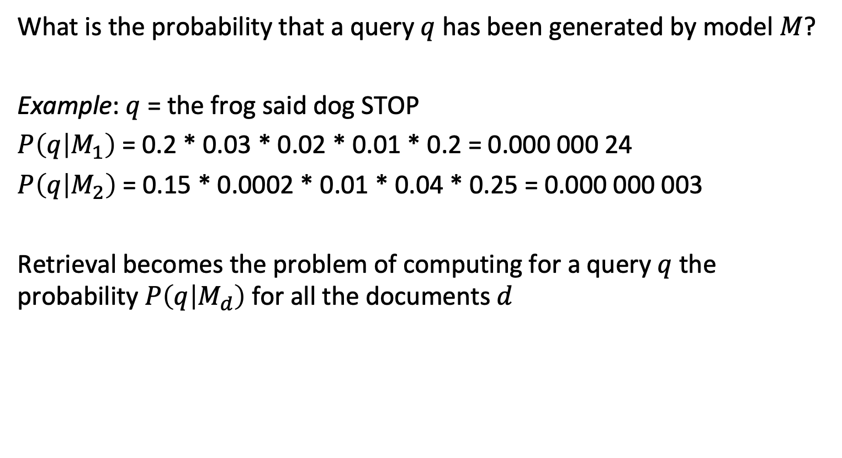
Probability to Create a Query
What is the probability that a query $q$ has been generated by model $M$?
Example: $q$ = the frog said dog STOP
$P\left(q | M_{1}\right)$= 0.2 * 0.03 * 0.02 * 0.01 * 0.2 = 0.000 000 24
$P\left(q | M_{2}\right)$= 0.15 * 0.0002 * 0.01 * 0.04 * 0.25 = 0.000 000 003
Retrieval becomes the problem of computing for a query $q$ the probability $P\left(q | M_{d}\right)$for all the documents $d$
Notes:
Given a language model for generation of documents, we can compute using that model the probability that a given query q has been generated by the model of a document d. We give an example showing such a computation. With this approach we are now ready to compute query likelihood for all documents of a document collection.

Slide 7
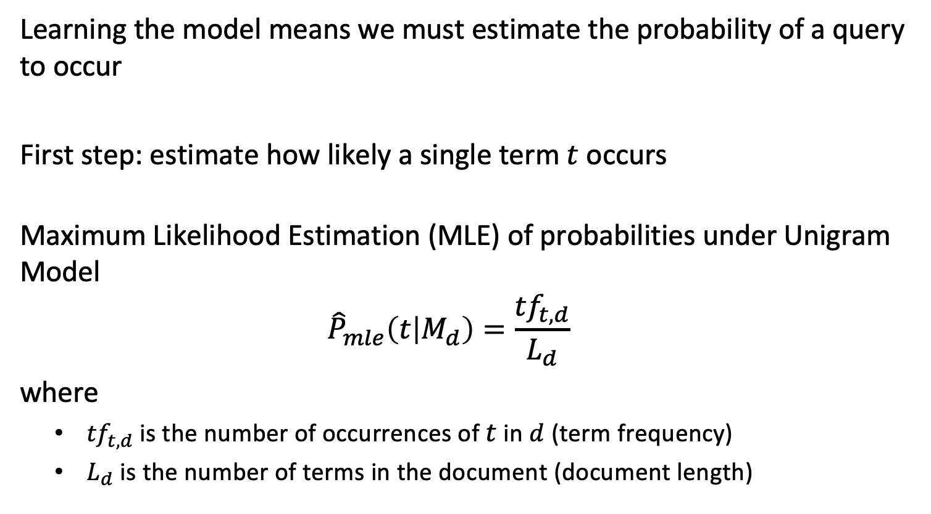
Learning the Model
Learning the model means we must estimate the probability of a query to occur
First step: estimate how likely a single term $t$ occurs
Maximum Likelihood Estimation (MLE) of probabilities under Unigram Model
$${\hat{P}}_{mle}\left(t | M_{d}\right)=\frac{{tf}_{t,d}}{L_{d}}$$ where
${tf}_{t,d}$ is the number of occurrences of $t$ in $d$ (term frequency)
$L_{d}$ is the number of terms in the document (document length)
Notes:
For applying the probabilistic retrieval method described before, we need to learn a language model of each document. The learning is performed using Maximum Likelihood Estimation (MLE). In the case of the unigram model, this is a straightforward task. We need to estimate the probabilities of terms to occur in a document. This is done by counting the number of occurrences of terms and normalizing by document length.

Slide 8

Using the Model
Independence assumption: different terms in a query are assumed to occur independently
$$\hat{P}\left(q | M_{d}\right)=\prod_{tεq}{{\hat{P}}_{mle}\left(t | M_{d}\right)}$$
Notes:
Based on the estimation of term probabilities we can compute a query probability, by making an independence assumptions on terms. This results in an estimation of the probability of a query to occur under a given document model.

Slide 9
Consider the document: “Information retrieval is the task of finding the documents satisfying the information needs of the user”
Using MLE to estimate the unigram probability model, what is P(the|M_{d}) and P(information|M_{d})?
1/16 and 1/16
1/12 and 1/12
1/4 and 1/8
1/3 and 1/6

Slide 10
Consider the following document
d = “information retrieval and search”
P(information search | M_{d}) > P(information | M_{d})
P(information search | M_{d}) = P(information | M_{d})
P(information search | M_{d}) < P(information | M_{d})

Slide 11
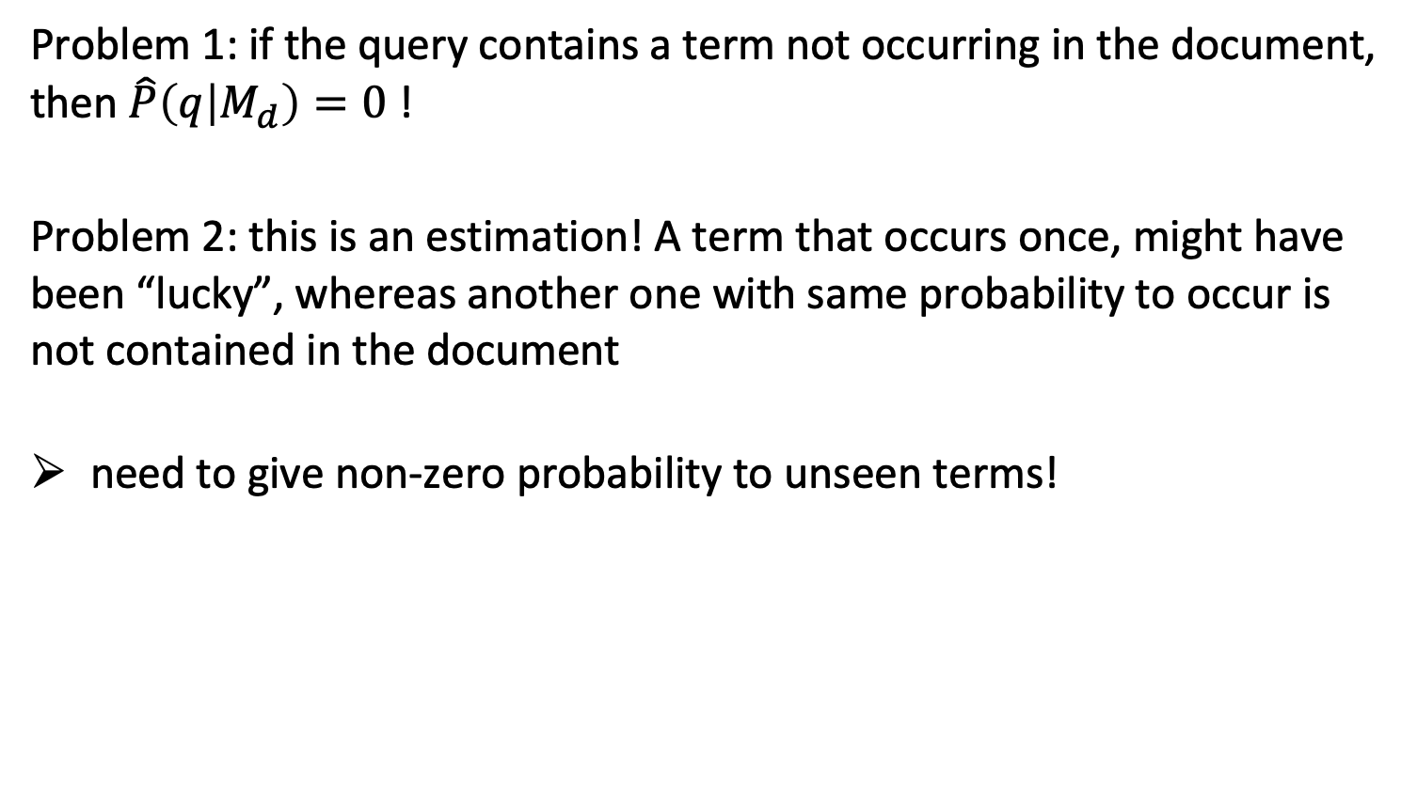
Issues with MLE
Problem 1: if the query contains a term not occurring in the document, then $\hat{P}\left(q | M_{d}\right)=0$ !
Problem 2: this is an estimation! A term that occurs once, might have been “lucky”, whereas another one with same probability to occur is not contained in the document
need to give non-zero probability to unseen terms!
Notes:
Applying the described approach to estimate relevance of a document to a query has a practical problem: if the query contains a term not occurring in the document the estimated probability will be unavoidably zero, since one of the factors of the product computing that probability will be zero. In other words, the query cannot be generated by the document model, thus the document is not relevant to the query. This is not only impractical, but also not meaningful from a more another perspective. Since we used MLE to generate the model, we were using the statistics of one specific document, that has been generated by a potentially complex document model. It might be the case that the specific generated document by chance does not contain certain terms that are part of the possible terms in the document according to the document model.

Slide 12
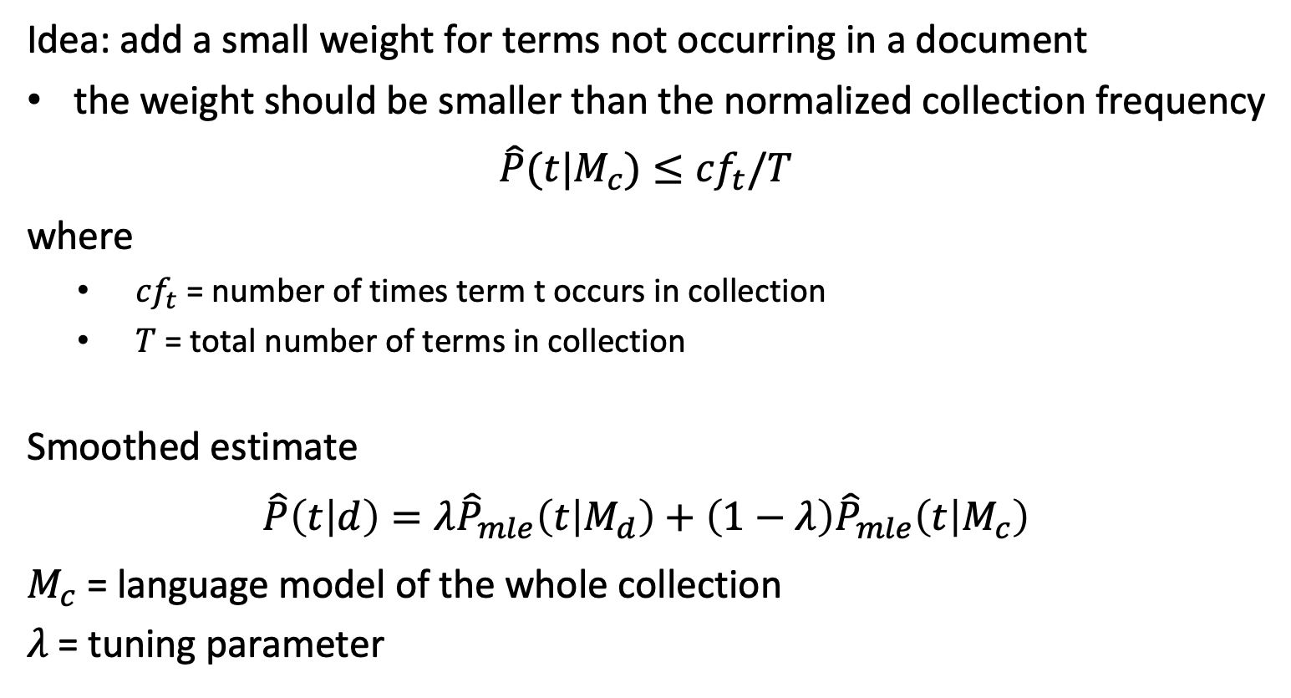
Smoothing
Idea: add a small weight for terms not occurring in a document
the weight should be smaller than the normalized collection frequency
$$\hat{P}(t|M_{c})≤{cf}_{t}/T$$
where
${cf}_{t}$ = number of times term t occurs in collection
$T$ = total number of terms in collection
Smoothed estimate
$$\hat{P}\left(t | d\right)=λ{\hat{P}}_{mle}\left(t | M_{d}\right)+\left(1−λ\right){\hat{P}}_{mle}\left(t | M_{c}\right)$$
$M_{c}$ = language model of the whole collection
$λ$= tuning parameter
Notes:
To address these problems an approach called smoothing is applied. The idea is to assume that in fact every term potentially could occur in the document generated by its document model, including those that are not part of the actual document; only that the probability of terms not seen in the document is presumably smaller than the probability of the term to occur in the overall document collection. The smoothed estimate then combines the estimated likelihood to occur in the document according to the document model, with the estimated likelihood of a term occurring in the general document collection, modeled as a generic language model using the statistics from the whole document collection.

Slide 13
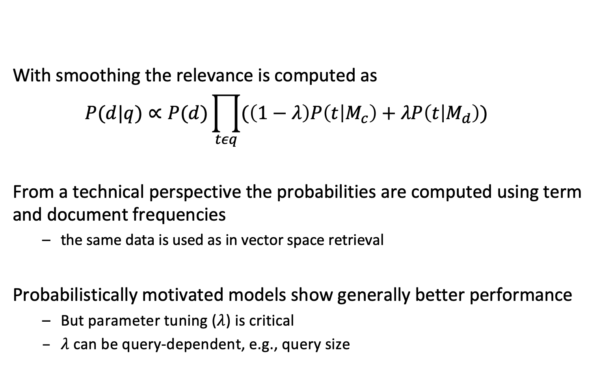
Probabilistic Retrieval
With smoothing the relevance is computed as
$$P(d|q)∝P(d)\prod_{tεq}{(\left(1−λ\right)P\left(t | M_{c}\right)+λP\left(t | M_{d}\right))}$$
From a technical perspective the probabilities are computed using term and document frequencies
the same data is used as in vector space retrieval
Probabilistically motivated models show generally better performance
But parameter tuning ($λ$) is critical
$λ$can be query-dependent, e.g., query size
Notes:
Here we summarize the approach for probabilistic retrieval. From a technical perspective computational cost of probabilistic retrieval is comparable to that vector space retrieval. The computation of the likelihoods for the document models requires to determine term frequencies, so in that sense it is equivalent. For deriving the collection model, the global term frequencies need to be computed, which again is like computing inverse document frequencies in a document collection.
In practice, the fine tuning of the model parameters (in that case $λ$) is essential for the model to perform well. It is also possible to make the parameter dependent on the query, in particular on the query size.

Slide 14
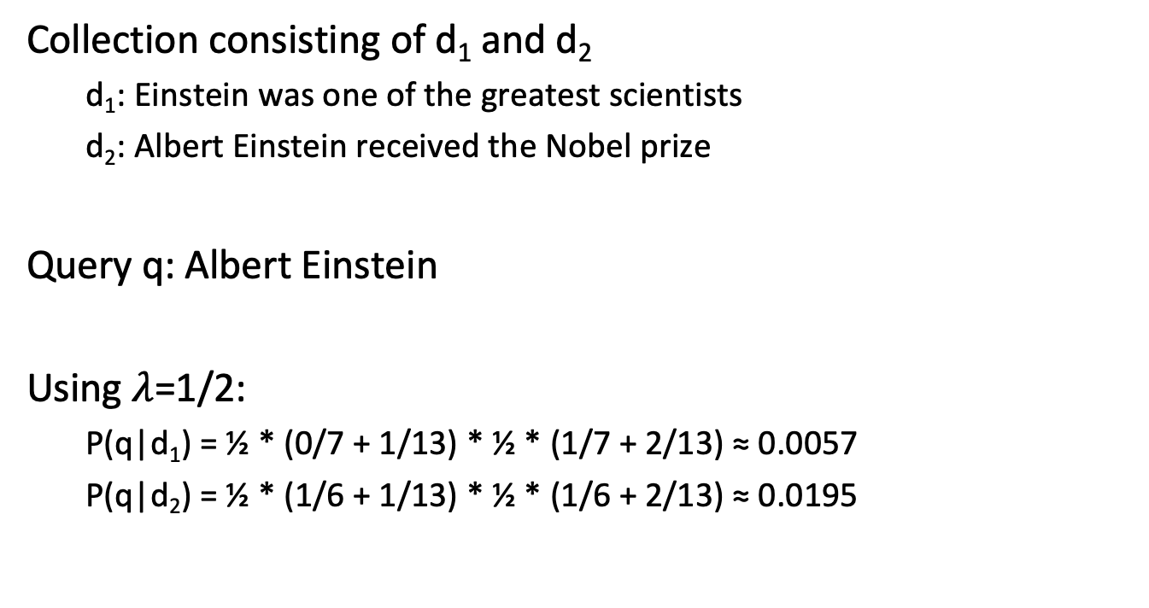
Example
Collection consisting of d₁ and d₂
d₁: Einstein was one of the greatest scientists
d₂: Albert Einstein received the Nobel prize
Query q: Albert Einstein
Using $λ$=1/2:
P(q|d₁) = ½ * (0/7 + 1/13) * ½ * (1/7 + 2/13) ≈ 0.0057
P(q|d₂) = ½ * (1/6 + 1/13) * ½ * (1/6 + 2/13) ≈ 0.0195
Albert
Einstein
Notes:
This is a simple example illustrating the use of probabilistic retrieval. Note that the document lengths of d1 and d2 are 7 and 6, and that the collection length is 13.

Slide 15
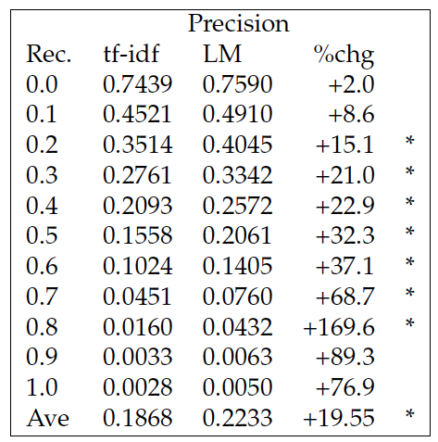
Example: Comparing VS and PR
Ponte & Croft, 1998
Notes:
This is a result reported from comparing vector space retrieval with probabilistic retrieval. In this experiment probabilistic retrieval improves precision significantly, in particular for higher values of recall. (LM = language model).

Slide 16
Properties of Retrieval Models
 | Vector Space Model | Language Model | BM25 (another prob. Model)
Model | geometric | probabilistic | probabilistic
Length normalization | Requires extensions (pivot normalization) | Inherent to model | Tuning parameters
Inverse document frequency | Used directly | Smoothing and collection frequency has similar effect | Used directly
Multiple term occurrences | Taken into account | Taken into account | Ignored
Simplicity | No tuning required | Tuning essential | Tuning essential
Notes:
Here we compare the characteristics of the vector space model with the probabilistic retrieval model based on language models that we have introduced. BM25 is another probabilistic model, that is today considered as one of the most performant retrieval models.
One aspect that is taken implicitly care off in the probabilistic retrieval model based on language models is normalization for document length. For vector space retrieval, specific modifications of the model are used, as we have seen earlier. For collections with widely varying document lengths this proved to be a useful improvement.
In general, the vector space model is preferred, when a quick and simple solution is sought. For probabilistic models, better performance can be achieved, but this depends on careful parameter tuning.

Slide 17
1.2.6 Query Expansion
If the user query does not contain any relevant term, a corresponding relevant document will not show up in the result
Example: query “car” will not return “automobile”
How to add such documents (increase recall)?
Idea: System adds query terms to user query!
Notes:
Users cannot predict or imagine all possible ways of how the concepts they are interested to find in their search can be expressed in natural language. Consequently, even under the vector space retrieval model, relevant results are missed, for the example, when the user does not provide different synonyms (different terms with the same meaning) in a query.
In information retrieval we are most of the time concerned about precision, since the assumption is that there exist many relevant documents. But in certain applications recall is more important. Good examples for this is searching for scientific publications, where only a few papers might be of interest or security-relevant applications where also rare risks need to be detected.
In the following we will see one possible approach to deal with this problem, namely extending the user query automatically by the system with additional query terms.

Slide 18
Two Methods for Extending Queries
1. Local Approach:
Use information from current query results: user relevance feedback
2. Global Approach:
Use information from a document collection: query expansion
Notes:
In the following we will present two types of approaches to query extension. They differ in the way of how new additional query terms are obtained. In the local approach the source of information is the current user query, respectively results produced by answering the user query. In the global approach, the source of information is an existing document collection, either the documents corpus that is queried by the user, or another, external collection of documents.

Slide 19
1.2.6.1 User Relevance Feedback
information items content
feature extraction
ranking system
ranked/ binary
result
?
query formulation
information need
!
browsing
system-modified query
(e.g. query term reweighting)
relevance feedback:
identify relevant results
Notes:
In general, a user does not necessarily know what is his information need and how to appropriately formulate a query. But usually, a user can well identify relevant documents. Therefore, the idea of user relevance feedback is to reformulate a query by taking into account feedback of the user on the relevance of already retrieved documents.
The advantages of such an approach are the following:
The user is not involved in query formulation, but just points to interesting data items.
The search task can be split up in smaller steps.
The search task becomes a process converging to the desired result.

Slide 20


Feedback from Users
Relevant documents C_{r}
Some retrieval result R
$$D_{r}$$
$D_{n}$
documents identified
by the user as being relevant
documents identified
by the user as being non-relevant
Notes:
The situation when receiving feedback from users can be described as follows: the retrieval system returns some result set R that is presented to the user. This result set overlaps with the set of relevant documents (C_{r}). The user can the identify within the result set both documents that are relevant and non-relevant. This gives the two feedback sets D_{r} and D_{n}.

Slide 21
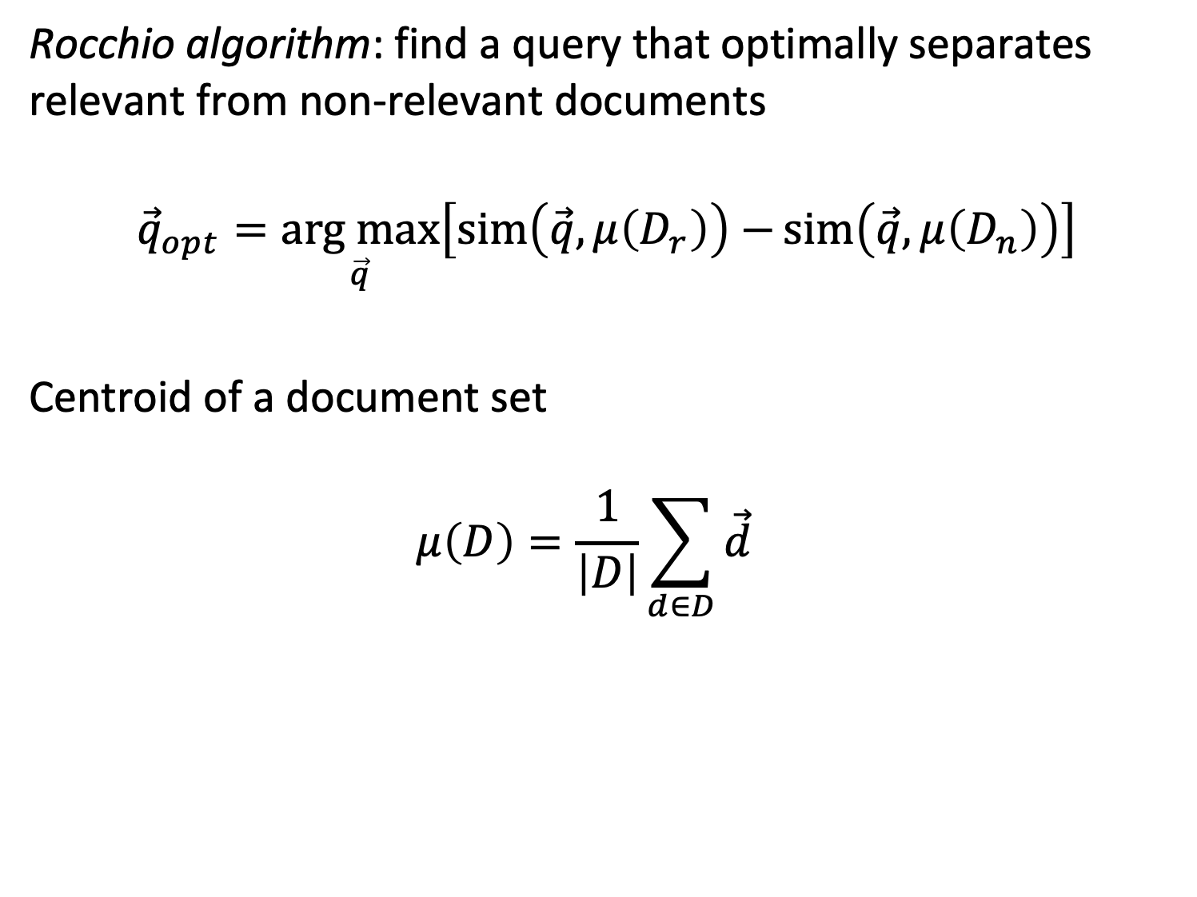
Rocchio Algorithm
Rocchio algorithm: find a query that optimally separates relevant from non-relevant documents
$${\vec{q}}_{opt}=\underset{\vec{q}}{arg max}\left[\operatorname{sim}\left(\vec{q},μ\left(D_{r}\right)\right)−{sim\left(\vec{q},μ\left(D_{n}\right)\right)}\right]$$
Centroid of a document set
$$μ\left(D\right)=\frac{1}{\left|D\right|}\sum_{d∈D}{\vec{d}}$$
Notes:
The basic approach for user relevance feedback was introduced by Rocchio. It is based on the observation, that the centroid of all document vectors of a document set D can be considered as the most characteristic representation of the document set. In order to to construct a query q_{opt} that optimally separates relevant from non-relevant documents, such a query has to have maximal similarity with the set of relevant documents, respectively its centroid, and maximal dissimilarity with the set of non-relevant documents, respectively its centroid. This can be achieved by finding a query that maximizes the difference among these two similarity values.

Slide 22
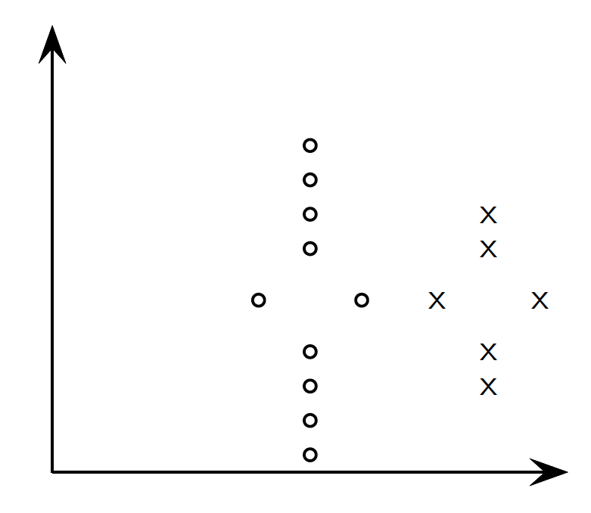

Illustration of Rocchio Algorithm
lower precision
lower recall
$$μ\left(D_{r}\right)$$
Notes:
We now motivate of how the optimal query vector can be found with an illustration. Assume that the relevant documents are marked by circles, and the non-relevant documents are marked by crosses, and that the vector space has 2 dimensions. When we consider the simply centroid of the relevant documents as a search query, then we see that we cannot achieve optimal precision and recall at the same time.

Slide 23


Illustration of Rocchio Algorithm
$$μ\left(D_{r}\right)−μ\left(D_{n}\right)$$
$$μ\left(D_{r}\right)$$
$$μ\left(D_{n}\right)$$
Notes:
We therefore consider also the centroid of the non-relevant documents as part of the user relevance feedback. We compute the difference vector among the two centroids, and we will use this difference vector to “move away” the query from the non-relevant documents.

Slide 24

Illustration of Rocchio Algorithm
Optimal recall and precision
$$μ\left(D_{r}\right)+\left[μ\left(D_{r}\right)−μ\left(D_{n}\right)\right]$$
$$μ\left(D_{r}\right)$$
Notes:
We add the difference vector to the centroid for the relevant documents. The resulting optimal query vector now can include all relevant documents in its result, without including non-relevant ones. In practice, such a clear separation will not always be achieved, but it has been shown that under some additional assumptions, this method is the optimal way to construct a query separating relevant from non-relevant documents.

Slide 25
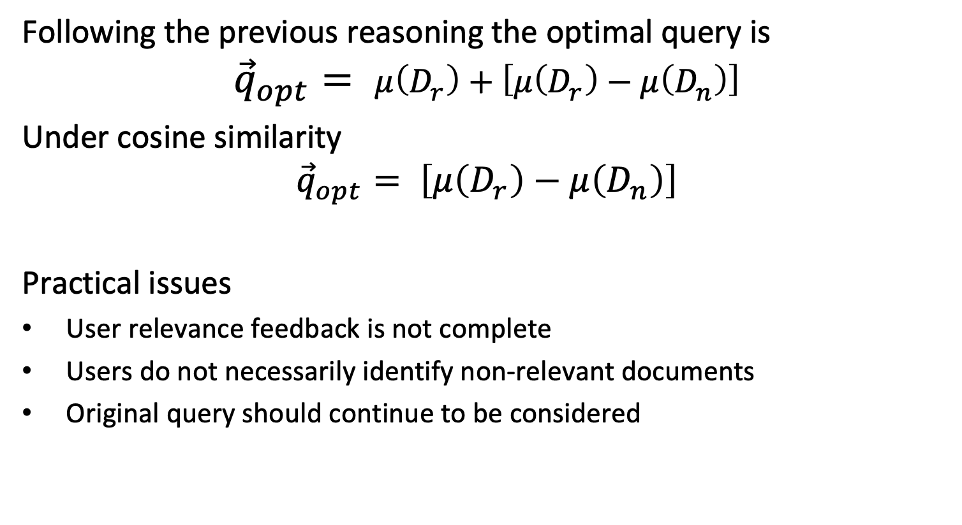
Identifying Relevant Documents
Following the previous reasoning the optimal query is
$${\vec{q}}_{opt}= μ\left(D_{r}\right)+\left[μ\left(D_{r}\right)−μ\left(D_{n}\right)\right]$$
Under cosine similarity
$${\vec{q}}_{opt}= \left[μ\left(D_{r}\right)−μ\left(D_{n}\right)\right]$$
Practical issues
User relevance feedback is not complete
Users do not necessarily identify non-relevant documents
Original query should continue to be considered
Notes:
We derived in the previous illustration an optimal query vector, under a model that uses Euclidean distance as metrics. This approach is frequently used for illustration of how such a vector can be constructed. Since in the vector space model we use cosine similarity as similarity measure, the optimal vector under this metric is different. It is given as the difference vector of the two centroids.
Constructing an optimal query vector as described is only theoretically possible, since the complete information on relevant and non-relevant documents is missing in practice. Therefore, the theoretical considerations serve as a basis to devise a practical scheme, that is approximating the theoretical optimal vector by a vector that can be constructed from available data.

Slide 26
SMART: Practical Relevance Feedback
Approximation scheme for the theoretically optimal query vector
If users identify some relevant documents D_{r} from the result set R of a retrieval query q
Assume all elements in R \ D_{r} are not relevant, i.e., D_{n} = R \ D_{r}
Modify the query to approximate theoretically optimal query
α, β, γ are tuning parameters, α, β, γ ≥ 0
Example: α =1, β = 0.75, γ = 0.25
Notes:
The approximation scheme for user relevance feedback is called SMART. It assumes that users have identified some relevant documents. Then the scheme assumes that all other documents should be considered as non-relevant. This results in a modification of the original query that is controlled by 3 tuning parameters.
Since the assumption that all documents that have not been marked relevant are non-relevant is of course not correct, two mechanisms are used to moderate the impact of this wrong assumption:
The original query vector is maintained, in order not to drift away too dramatically from the original user query.
The weight given for the modification using the centroid of non-relevant documents is generally kept lower than the weight for the centroid of the relevant documents

Slide 27
Example
Query q= "application theory"
Result
Query reformulation
Result for reformulated query
0.77: B17 The Double Mellin-Barnes Type Integrals and Their Applications to Convolution Theory
0.68: B3 Automatic Differentiation of Algorithms: Theory, Implementation, and Application
0.23: B11 Oscillation Theory for Neutral Differential Equations with Delay
0.23: B12 Oscillation Theory of Delay Differential Equations
0.87: B3 Automatic Differentiation of Algorithms: Theory, Implementation, and Application
0.61: B17 The Double Mellin-Barnes Type Integrals and Their Applications to Convolution Theory
0.29: B7 Knapsack Problems: Algorithms and Computer Implementations
0.23: B5 Ideals, Varieties, and Algorithms: An Introduction to Computational Algebraic Geometry and Commutative Algebra
Notes:
This example shows how the query reformulation works. By identifying document B3 as being relevant and modifying the query vector it turns out that new documents (B5 and B7) become relevant. The reason is that those new documents share terms with document B3, and these terms are newly considered in the reformulated query.

Slide 28
Discussion
Underlying assumptions of SMART algorithm
Original query contains sufficient number of relevant terms
Results contain new relevant terms that co-occur with original query terms
Relevant documents form a single cluster
Users are willing to provide feedback (!)
All assumptions can be violated in practice
Practical considerations
Modified queries are complex → expensive processing
Explicit relevance feedback consumes user time → could be used in other ways
Notes:
Concerning the first assumption, if the initial query of the user does not contain sufficient information to retrieve a sufficiently large number of documents that are relevant to the true interest of the user (i.e., has sufficient recall), the relevance feedback system will not be able to discover additional relevant terms.
Concerning the second assumption, new terms can only be included as part of the modified query, if they co-occur at least in some documents together with original query terms. Otherwise, these terms could never be part of relevant documents in the result of the original query (why?).
Concerning the third assumption, implicitly the SMART algorithm assumes that all relevant documents are part of one cluster in the vector space. If they form multiple clusters, it is not able to correctly produce a query that can retrieve the relevant documents.

Slide 29
Can documents which do not contain any keywords of the original query receive a positive similarity coefficient after relevance feedback?
No
Yes, independent of the values β and γ
Yes, but only if β > 0
Yes, but only if γ > 0

Slide 30
Which year Rocchio published his work on relevance feedback?
1965
1975
1985
1995

Slide 31
Pseudo-Relevance Feedback
If users do not give feedback, automate the process
Choose the top-k documents as the relevant ones
Extend the query by selecting from the top-k documents the most relevant terms, according to some weighting scheme
Alternatively: apply the SMART algorithm
Works often well
But can fail horribly: query drift
Notes:
The idea of relevance feedback has also been adopted for an automated extension of queries. Instead of the user selecting relevant documents, the system automatically chooses the top-k results as the set of relevant documents and then extends the query either by selecting some most relevant terms using a weighting scheme or applying the SMART algorithm.
This works well if the original query already separates well the topic of interest from other topics. If this is not the case, the method can fail catastrophically, driving the query towards a topic that is different from the originally intended one, where irrelevant query terms reinforce each other.

Slide 32
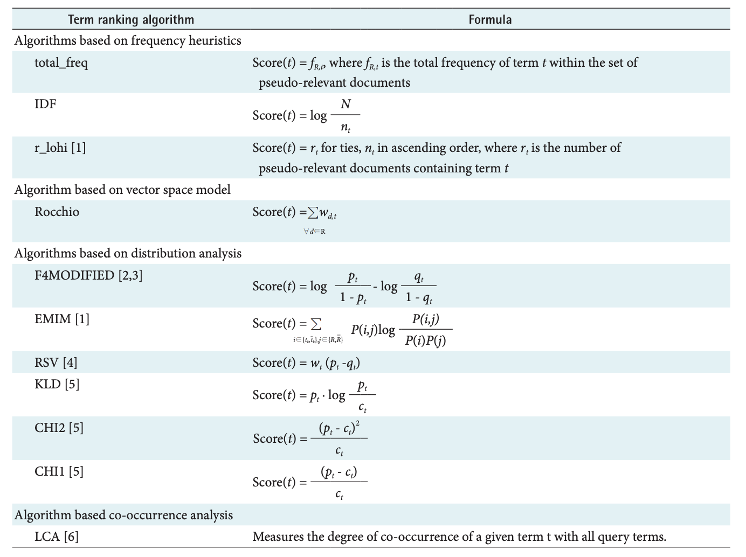
Weighting Schemes
Notes:
These are examples of weighting schemes that have been considered for pseudo-relevance feedback.

Slide 33
1.2.6.2 Global Query Expansion
Query is expanded using a global, query-independent resource
Manually edited thesaurus
Automatically extracted thesaurus
Query logs
Notes:
Global methods for expanding user queries can rely on a variety of resources. These may be thesauri that are manually constructed or automatically derived (a thesaurus is a database that contains words and their synonyms), or the automated analysis of query logs.

Slide 34
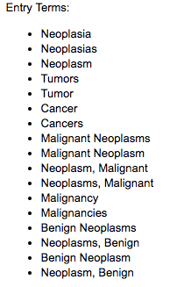
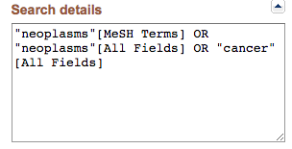
Manually Created Thesaurus
Expensive to create and maintain
Used mainly in science and engineering
Example: Pubmed
https://www.ncbi.nlm.nih.gov/pubmed/?term=cancer
Notes:
Performing query expansion using a manually thesaurus requires the (expensive) effort of creating and maintaining such a thesaurus. This task is mainly performed in highly specialized technical fields in science and engineering. One prominent example of such a Thesaurus is maintained by Pubmed, the biggest publication database for medical literature maintained by the NIH, the National Institute of Health in the US. When using its search engine, you will find a window ”Search details” that shows how the user query is automatically expanded using the Pubmed thesaurus. In this example we see that the search system identifies that “cancer” is an entry on the concept “neoplasms”, and thus extends the query with all entries that it finds associated in the thesaurus (e.g., it would also search for “tumor”).

Slide 35
Automatic Thesaurus Generation
Generate a thesaurus automatically by analyzing the distribution of words in documents
Problem: find words with similar meaning (synonyms)
Approach 1: Two words are similar if they co-occur with similar words “switzerland” ≈ “austria” because both occur with words such as “national”, “election”, “soccer” etc., so they must be similar.
Approach 2: Two words are similar if they occur in the same text pattern “live in *”, “travel to *”, “size of *” are all phrases in which both “switzerland” or “austria” can occur
Notes:
In order to avoid the effort of manually creating a thesaurus one can find methods to create it automatically by studying large numbers of documents and the distribution of words in those. This leads to the concept of word similarity. There exists two basic methods to study this similarity, either statistically, by observing which words occur together in documents, or in a more accurate way by identifying whether the words occur in the same text patterns.
We will study later in the lecture such methods in more detail. For the first approach, we will study so-called “word embeddings”. For the second approach, we will learn about this type of methods in “information extraction”.

Slide 36
Expansion using Query Logs
Query logs are an important resource for query expansion with search engines
Exploit correlations in user sessions
Example 1: users extend query
After searching “Obama”, users search “Obama president”
Therefore, ”president” might be a good expansion
Example 2: users refer to same result
User A accesses URL epfl.ch after searching “Aebischer”
User B accesses URL epfl.ch after searching “Vetterli”
“Vetterli” might be a potential expansion for the query “Aebischer”
Notes:
Query logs contain potentially rich information for query expansion. There are different ways of how such knowledge can be exploited. We show here two possibilities.
Other methods rely on mining query logs using various techniques, including clustering and association rule mining, that we will introduce later in the lecture in the part on “data mining”.

Slide 37
References
Papers
Rocchio, J. (1971). Relevance feedback in information retrieval. The Smart retrieval system-experiments in automatic document processing, 313-323.
Ponte, Jay Michael, and W. Bruce Croft. "A language modeling approach to information retrieval." PhD diss., University of Massachusetts at Amherst, 1998.
Yoo, S., & Choi, J. (2011). Evaluation of term ranking algorithms for pseudo-relevance feedback in MEDLINE retrieval. Healthcare informatics research, 17(2), 120-130.

